Slide 1
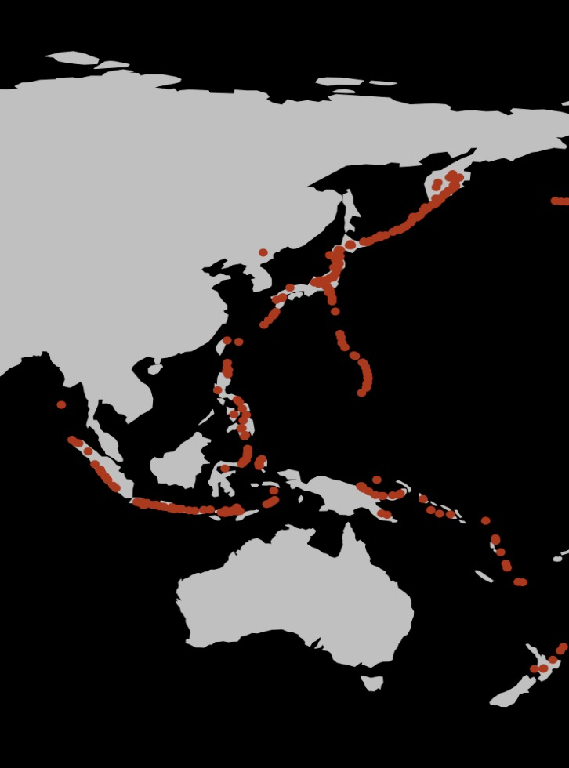
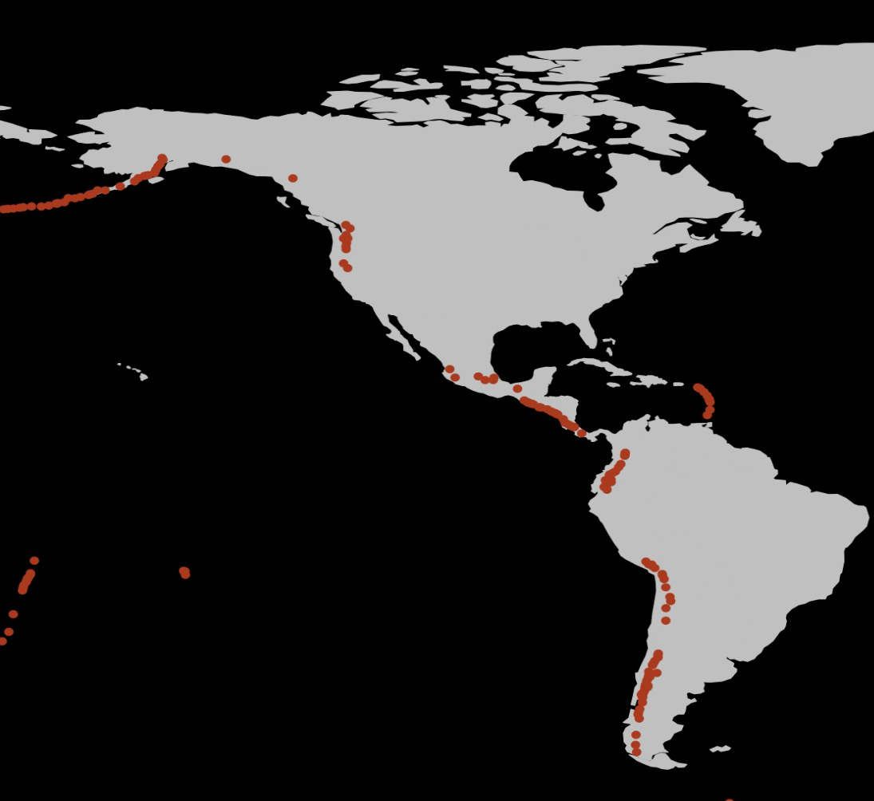
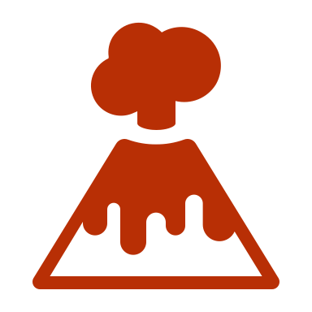
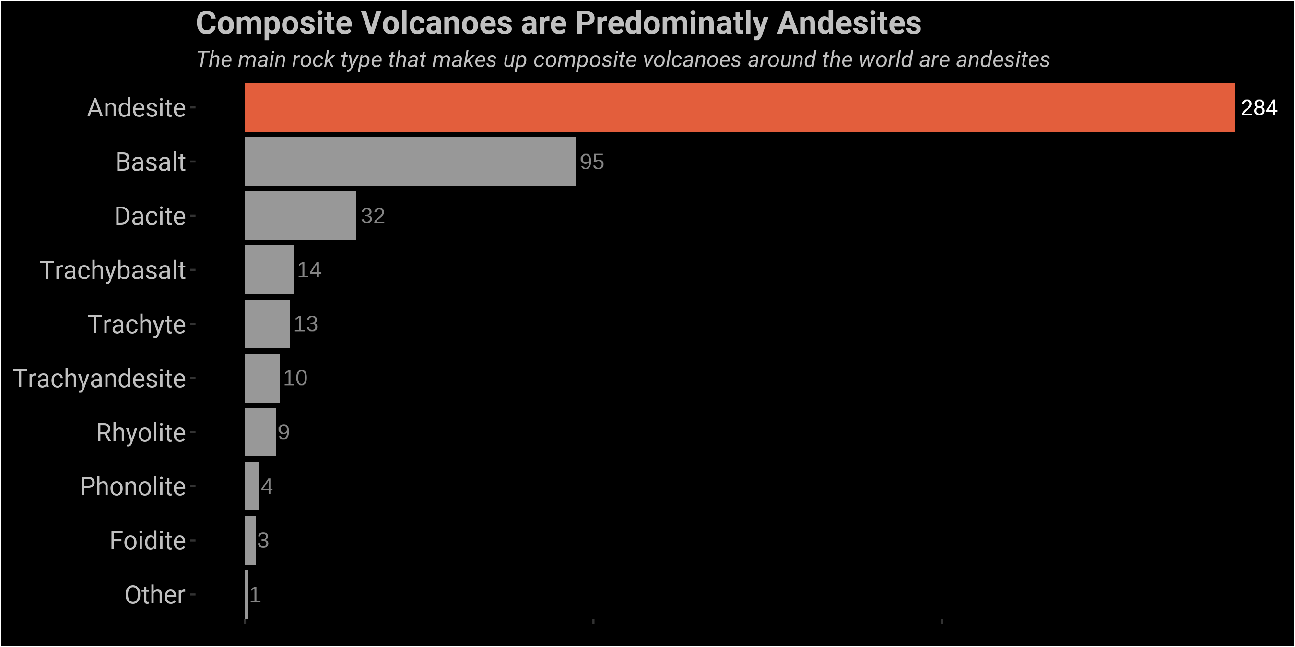

What is a Composite Volcano?
Composite volcanoes are large volcanoes present around the Ring of Fire, an area that borders the Pacific Ocean with high levels of volcanic activity. What causes these volcanoes to arise here, and how can we see this in the rock record?
A specific type of volcano, a composite or stratovolcano dominates the Ring of Fire
Composite Volcano
Examples of famous composite volcanoes include Mount Ranier in Washington and Mount Fuji in Japan. But what do these volcanoes have in common?
Rift Zone
16%
Most composite volcanoes are andesitic in composition, which means they formed by the mixing of continental and oceanic magma
Intraplate 10%
This mixing occurs deep in the Earth, where oceanic tectonic plates dive below continental plates, also called a subduction zone
Once enough magma has built up, it rises to the surface and forms a composite volcano!
Subduction Zone 73%

